Slide 1














HOME
PRESCRIBER
PATIENT
RESOURCES
What is
JINARC® RMP?
Prescriber
Requirement
Patient
Requirement
What is ADPKD?
Full prescribing information available from Tolvaptan (Jinarc®) Package insert
Tolvaptan (Jinarc®) [Package Insert]. Tokushima, Japan; OPC; December. 2022.

Slide 2
HOME
PRESCRIBER
PATIENT
RESOURCES
What is
JINARC® RMP?
Prescriber
Requirement
Patient
Requirement
What is ADPKD?
Full prescribing information available from Tolvaptan (Jinarc®) Package insert
Tolvaptan (Jinarc®) [Package Insert]. Tokushima, Japan; OPC; December. 2022.

Slide 3
HOME
PRESCRIBER
PATIENT
RESOURCES
What is
JINARC® RMP?
Prescriber
Requirement
Patient
Requirement
What is ADPKD?
Full prescribing information available from Tolvaptan (Jinarc®) Package insert
Tolvaptan (Jinarc®) [Package Insert]. Tokushima, Japan; OPC; December. 2022.

Slide 4
HOME
PRESCRIBER
PATIENT
RESOURCES
What is
JINARC® RMP?
Prescriber
Requirement
Patient
Requirement
What is ADPKD?
Full prescribing information available from Tolvaptan (Jinarc®) Package insert
Tolvaptan (Jinarc®) [Package Insert]. Tokushima, Japan; OPC; December. 2022.

Slide 5

HOME
PRESCRIBER
PATIENT
RESOURCES
What is
JINARC® RMP?
Prescriber
Requirement
Patient
Requirement
What is ADPKD?
Full prescribing information available from Tolvaptan (Jinarc®) Package insert
Tolvaptan (Jinarc®) [Package Insert]. Tokushima, Japan; OPC; December. 2022.

Slide 6


HOME
PRESCRIBER
PATIENT
RESOURCES
What is
JINARC® RMP?
Prescriber
Requirement
Patient
Requirement
What is ADPKD?
Full prescribing information available from Tolvaptan (Jinarc®) Package insert
Tolvaptan (Jinarc®) [Package Insert]. Tokushima, Japan; OPC; December. 2022.

Slide 7




HOME
PRESCRIBER
PATIENT
RESOURCES
What is
JINARC® RMP?
Prescriber
Requirement
Patient
Requirement
What is ADPKD?
Full prescribing information available from Tolvaptan (Jinarc®) Package insert
Tolvaptan (Jinarc®) [Package Insert]. Tokushima, Japan; OPC; December. 2022.

Slide 8



HOME
PRESCRIBER
PATIENT
RESOURCES
What is
JINARC® RMP?
Prescriber
Requirement
Patient
Requirement
What is ADPKD?
Full prescribing information available from Tolvaptan (Jinarc®) Package insert
Tolvaptan (Jinarc®) [Package Insert]. Tokushima, Japan; OPC; December. 2022.

Slide 9
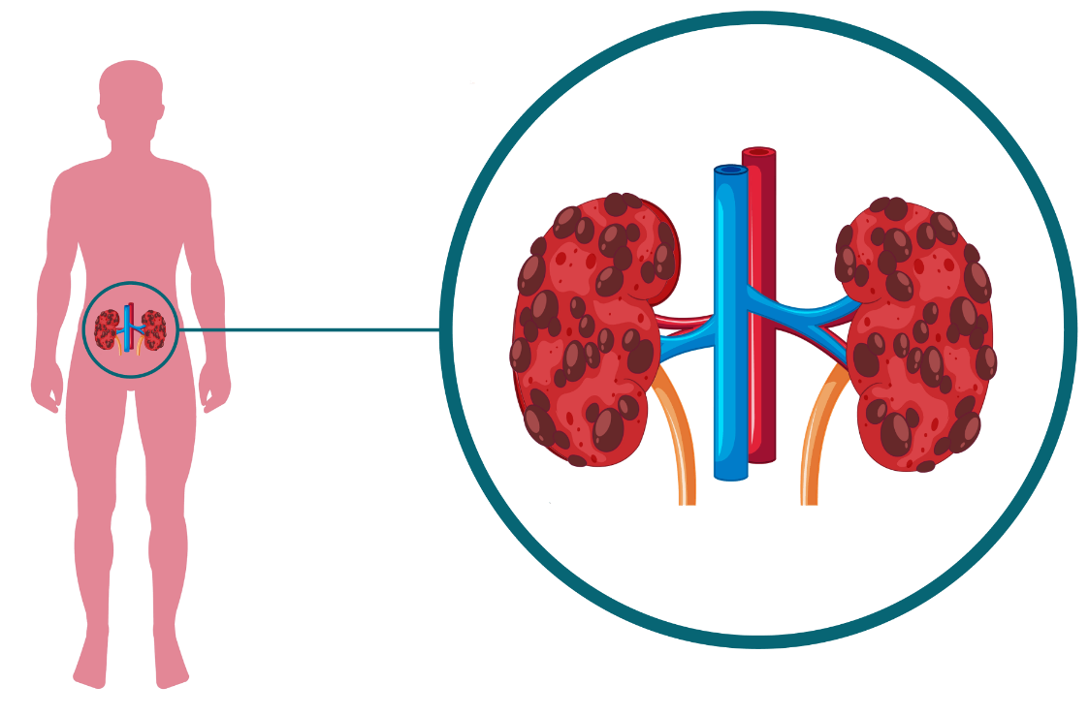
HOME
PRESCRIBER
PATIENT
RESOURCES
What is
JINARC® RMP?
Prescriber
Requirement
Patient
Requirement
What is ADPKD?
Full prescribing information available from Tolvaptan (Jinarc®) Package insert
Tolvaptan (Jinarc®) [Package Insert]. Tokushima, Japan; OPC; December. 2022.
What is ADPKD?
TOP
Autosomal Dominant Polycystic Kidney Disease (ADPKD) is a hereditary & progressive disease characterized by gradual enlargement of cysts in both kidneys leading to renal insufficiency, or reduction in kidney function, ultimately leading to End-Stage Renal Disease (ESRD).

Slide 10
What is
JINARC® RMP?
Prescriber
Requirement
Patient
Requirement
What is ADPKD?
Autosomal Dominant Polycystic Kidney Disease (ADPKD) is a hereditary & progressive disease characterized by gradual enlargement of cysts in both kidneys leading to renal insufficiency, or reduction in kidney function, ultimately leading to End-Stage Renal Disease (ESRD).
TOP

Slide 11
Prescriber
Requirement
Patient
Requirement
What is ADPKD?
What is JINARC® RMP?
The JINARC® RMP (Risk Management Program) is designed to manage the risk of serious and potentially fatal liver injury associated with using JINARC®, and the RMP ensures that the benefits of using JINARC® outweigh its risks.
There have been reports of acute liver failure requiring liver transplantation in patients with ADPKD on the post-marketing ADPKD experience. Discontinuation in response to laboratory abnormalities or sign or symptoms* of liver injury can reduce the risk of severe hepatotoxicity.
* These symptoms may include: fatigue, nausea, abdominal discomfort, fever, rash, yellowing of the skin or eyes, dark urine, or itching.
TOP

Slide 12
What is
JINARC® RMP?
Patient
Requirement
What is ADPKD?
FOR PRESCRIBERS
To prescribe JINARC®, healthcare providers need to follow these steps:
Complete a one-time certification process by passing the Prescriber Knowledge Assessment.
Counsel patients and conduct baseline liver testing before enrolling them in the RMP, then write the prescription.
Continuously monitor patients, conducting liver testing at specific intervals* during the first 18 months of treatment, and then every 3 months thereafter.
Prescriber Knowledge Assessment
* These intervals include 2 weeks and 4 weeks after your first dose and monthly for the first 18 months of treatment.
TOP

Slide 13
What is
JINARC® RMP?
Prescriber
Requirement
What is ADPKD?
FOR PATIENTS
To receive JINARC®, patients need to follow these steps:
Understand risks associated with JINARC®.
Enroll in the RMP by calling JINARC® Patient Support Team.
Complete baseline liver testing before taking your first dose, and then at specific intervals* during the first 18 months of treatment, and every 3 months thereafter.
* These intervals include 2 weeks and 4 weeks after your first dose and monthly for the first 18 months of treatment.
TOP

